Slide 1
Kinodynamic Motion Planning
Lecture 4

Slide 2
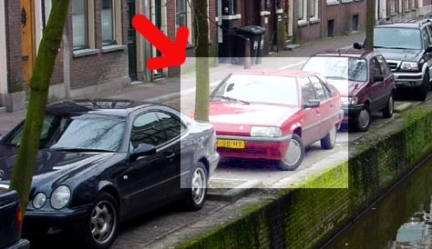
Kinodynamic Motion Planning
Planning in robotics is often not just a geometrically feasible path from one location to another. When kinematic or dynamic constraints are present, planning becomes non-trivial. The simple car-parking problem illustrates this.

Slide 3
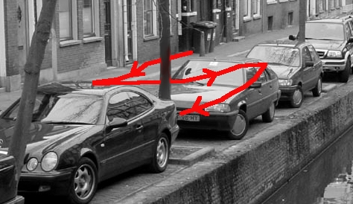
Introduction (contd.)

Slide 4
Kinematics
kinematics
dynamics
The effect of a robot’s geometry on its motion.
The effect of all forces (internal and external) on a robot’s motion.
If the motors move this much, where will the robot be?
If the motors apply this much force, where will the robot be?
Assumes that we control encoder readings…
Assumes that we control motor current…

Slide 5
Differential drive
Most common kinematic choice
- difference in wheels’ speeds determines its turning angle
Most miniature robots…
ER1, Pioneer, Rug warrior
Questions (forward kinematics)
Given the wheel’s velocities or positions, what is the robot’s velocity/position ?
V_{L}
Are there any inherent system constraints?
V_{R}
1) Specify system measurements
2) Determine the point (the radius) around which the robot is turning.
3) Determine the speed at which the robot is turning to obtain the robot velocity.
4) Integrate to find position.

Slide 6
Differential drive
1) Specify system measurements
y
- consider possible coordinate systems
V_{L}
x
θ
2d
V_{R}

Slide 7
Differential drive
1) Specify system measurements
y
- consider possible coordinate systems
2) Determine the point (the radius) around which the robot is turning.
V_{L}
x
θ
2d
V_{R}

Slide 8
Differential drive
1) Specify system measurements
y
- consider possible coordinate systems
2) Determine the point (the radius) around which the robot is turning.
- to minimize wheel slippage or lateral motion, the instantaneous center of curvature (the ICC) must lie at the intersection of the wheels’ axles
V_{L}
x
θ
- each wheel must be traveling at the same angular velocity
2d
V_{R}

Slide 9
Differential drive
1) Specify system measurements
y
- consider possible coordinate systems
2) Determine the point (the radius) around which the robot is turning.
ω
- to minimize wheel slippage, this point (the ICC) must lie at the intersection of the wheels’ axles
V_{L}
x
- each wheel must be traveling at the same angular velocity around the ICC
θ
2d
V_{R}
ICC “instantaneous center of curvature”
(assume the wheel diameter is accounted for already)

Slide 10
Differential drive
1) Specify system measurements
y
- consider possible coordinate systems
2) Determine the point (the radius) around which the robot is turning.
ω
- each wheel must be traveling at the same angular velocity around the ICC
V_{L}
x
3) Determine the robot’s speed around the ICC and its linear velocity
2d
V_{R}
ICC
ω(R+d) = V_{L}
R
robot’s turning radius
ω(R-d) = V_{R}

Slide 11
Differential drive
1) Specify system measurements
y
- consider possible coordinate systems
2) Determine the point (the radius) around which the robot is turning.
ω
- each wheel must be traveling at the same angular velocity around the ICC
V_{L}
x
3) Determine the robot’s speed around the ICC and its linear velocity
2d
V_{R}
ICC
ω(R+d) = V_{L}
of these five, what’s known & what’s not?
R
robot’s turning radius
ω(R-d) = V_{R}

Slide 12
Differential drive
1) Specify system measurements
y
- consider possible coordinate systems
2) Determine the point (the radius) around which the robot is turning.
ω
- each wheel must be traveling at the same angular velocity around the ICC
V_{L}
x
3) Determine the robot’s speed around the ICC and its linear velocity
2d
V_{R}
ICC
ω(R+d) = V_{L}
R
robot’s turning radius
ω(R-d) = V_{R}
Thus,
ω = ( V_{R} - V_{L} ) / 2d
are there interesting cases?
R = d ( V_{R} + V_{L} ) / ( V_{R} - V_{L} )

Slide 13
Differential drive
1) Specify system measurements
y
- consider possible coordinate systems
2) Determine the point (the radius) around which the robot is turning.
ω
- each wheel must be traveling at the same angular velocity around the ICC
V
V_{L}
x
3) Determine the robot’s speed around the ICC and its linear velocity
2d
V_{R}
ICC
ω(R+d) = V_{L}
R
robot’s turning radius
ω(R-d) = V_{R}
Thus,
ω = ( V_{R} - V_{L} ) / 2d
R = d ( V_{R} + V_{L} ) / ( V_{R} - V_{L} )
So, what is the robot’s velocity?

Slide 14
Differential drive
1) Specify system measurements
y
- consider possible coordinate systems
2) Determine the point (the radius) around which the robot is turning.
ω
- each wheel must be traveling at the same angular velocity around the ICC
V
V_{L}
x
3) Determine the robot’s speed around the ICC and its linear velocity
2d
V_{R}
ICC
ω(R+d) = V_{L}
R
robot’s turning radius
ω(R-d) = V_{R}
Thus,
ω = ( V_{R} - V_{L} ) / 2d
R = d ( V_{R} + V_{L} ) / ( V_{R} - V_{L} )
So, the robot’s velocity is
V = ωR = ( V_{R} + V_{L} ) / 2

Slide 15
Differential drive
4) Integrate to obtain position
y
V_{x} = V cos(θ )
ω
V_{y} = V sin(θ )
V
V_{L}
x
2d
V_{R}
ICC
R
robot’s turning radius
with
ω = ( V_{R} - V_{L} ) / 2d
R = d ( V_{R} + V_{L} ) / ( V_{R} - V_{L} )
What has to happen to change the ICC ?
V = ωR = ( V_{R} + V_{L} ) / 2

Slide 16
Differential drive
4) Integrate to obtain position
y
V_{x} = V(t) cos(θ(t))
ω(t)
V_{y} = V(t) sin(θ(t))
V(t)
V_{L}
x
2d
V_{R}
ICC
R(t)
robot’s turning radius
with
ω = ( V_{R} - V_{L} ) / 2d
R = d ( V_{R} + V_{L} ) / ( V_{R} - V_{L} )
What has to happen to change the ICC ?
things have to change over time, t
V = ωR = ( V_{R} + V_{L} ) / 2

Slide 17
Differential drive
4) Integrate to obtain position
y
V_{x} = V(t) cos(θ(t))
ω(t)
V_{y} = V(t) sin(θ(t))
Thus,
V(t)
x(t) = ∫ V(t) cos(θ(t)) dt
V_{L}
x
y(t) = ∫ V(t) sin(θ(t)) dt
2d
θ(t) = ∫ ω(t) dt
V_{R}
ICC
R(t)
robot’s turning radius
with
ω = ( V_{R} - V_{L} ) / 2d
R = d ( V_{R} + V_{L} ) / ( V_{R} - V_{L} )
What has to happen to change the ICC ?
things have to change over time, t
V = ωR = ( V_{R} + V_{L} ) / 2

Slide 18
Differential drive
4) Integrate to obtain position
y
V_{x} = V(t) cos(θ(t))
ω(t)
V_{y} = V(t) sin(θ(t))
Thus,
V(t)
x(t) = ∫ V(t) cos(θ(t)) dt
V_{L}
x
y(t) = ∫ V(t) sin(θ(t)) dt
2d
θ(t) = ∫ ω(t) dt
V_{R}
ICC
R(t)
Kinematics
robot’s turning radius
with
ω = ( V_{R} - V_{L} ) / 2d
R = d ( V_{R} + V_{L} ) / ( V_{R} - V_{L} )
What has to happen to change the ICC ?
things have to change over time, t
V = ωR = ( V_{R} + V_{L} ) / 2

Slide 19
Synchro drive
Nomad 200
wheels rotate in tandem and remain parallel
all of the wheels are driven at the same speed

Slide 20
Synchro drive
Nomad 200
wheels rotate in tandem and remain parallel
all of the wheels are driven at the same speed
Questions (forward kinematics)
Given the wheel’s velocities or positions, what is the robot’s velocity/position ?
Are there any inherent system constraints?
1) Specify system measurements
2) Determine the point (the radius) around which the robot is turning.
3) Determine the speed at which the robot is turning to obtain the robot velocity.
4) Integrate to find position.
Where is the ICC ?

Slide 21
Synchro drive
Nomad 200
wheels rotate in tandem and remain parallel
all of the wheels are driven at the same speed
ICC at ∞
y
V_{robot} = V_{wheels}
velocity
ω
ω_{robot} = ω_{wheels}
θ
x
θ(t) = ∫ ω(t) dt
V_{wheels}
x(t) = ∫ V_{wheels}(t) cos(θ(t)) dt
position
y(t) = ∫ V_{wheels}(t) sin(θ(t)) dt

Slide 22
Synchro drive
Nomad 200
wheels rotate in tandem and remain parallel
all of the wheels are driven at the same speed
ICC at ∞
y
V_{robot} = V_{wheels}
velocity
ω
ω_{robot} = ω_{wheels}
θ
x
Kinematics
θ(t) = ∫ ω(t) dt
V_{wheels}
x(t) = ∫ V_{wheels}(t) cos(θ(t)) dt
position
y(t) = ∫ V_{wheels}(t) sin(θ(t)) dt

Slide 23
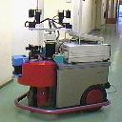
Tricycle drive
Mecos tricycle-drive robot
The velocity of the front wheel is V_{F}
V_{F}
(i.e., the conversion from angular velocity with wheel diameter is already done…)
B
V_{L}
We know the distances 2d and B
2d
V_{R}
What else do we need to know?
Where is the ICC?
How fast is the trikebot rotating around it?
What are V_{L} and V_{R} ?

Slide 24
Tricycle drive
front wheel is powered and steerable
back wheels tag along...
Mecos tricycle-drive robot
Starting from
α
α, the robot’s steering angle
ω
V_{F} = ω B / sin(α)
V_{F}
We conclude
B
= V_{F} sin(α) / B
R = B / tan(α)
V = ωR = V_{F} cos(α)
V_{L} = ω(R+d) = V + dV_{F} sin(α) / B
V_{R} = ω(R-d) = V - dV_{F} sin(α) / B
V
Kinematics
V_{L}
2d
V_{R}
α
R
robot’s turning radius
( velocity only )

Slide 25
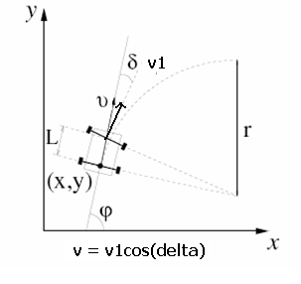
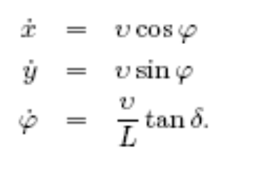
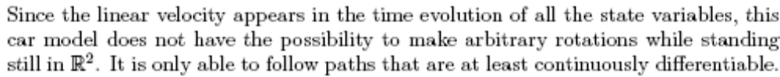
Kinematics of the Car
Integrating above equations you will find the car moves in a circle of radius Lcot(delta)
Delta = 0 corresponds to an infinite turning radius or a straight line,
NOTE:

Slide 26
Solution 1: Minimum Reversals Method
Let initial state or configuration of the robot be X0. Add this state to a tree T
Generate discrete successors for the current state X (a leaf node of T) by varying the steering angle delta in the kinematic equations for the car. Each delta gives a successor node, call it Xn.
Among the generated successors Xn (all the leaf nodes of T so far) choose the node with minimum number of reversals and insert it into a heap it is collision free. This step is repeated till a collision free successor node is found
Now X = top most node in the heap
If X is the goal state or near the goal state STOP else repeat 2 to 4 till goal is reached or heap is empty

Slide 27
Basic RRT Algorithm
Suitable for rapidly exploring space
Inefficient for one-time queries
ISSUES:
Choice of distance metric
Choice of thresholds – how much error in final position to allow
Choice of data-structure for search
RRT-Explore (Tree T, Vertex src)
1: T = {src}
2: for k = 1 to K //(K number of random nodes in workspace W)
3: X_{k} = Random-State( )//one such random node
4: Xn = Nearest-Neighbour(T, X)// finds the node among the leaf nodes that is closest to X_{k}
5: Xs = SuccessorState(Xn, X, U) //generates a successor to Xn, Xs, that takes Xs closer to X_{k} on some metric
6: if( collision-free( Xs ) )
7: then T = T U { Xs }

Slide 28
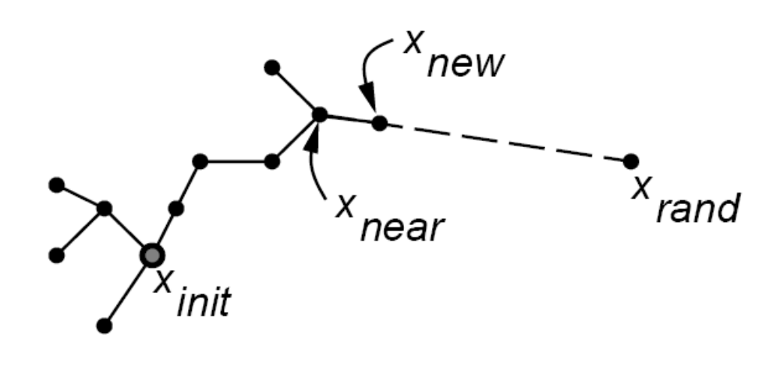
RRT (illustration)

Slide 29
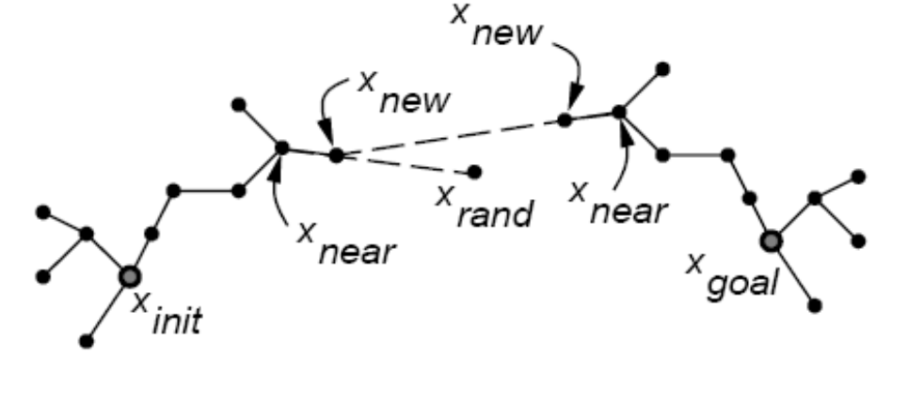
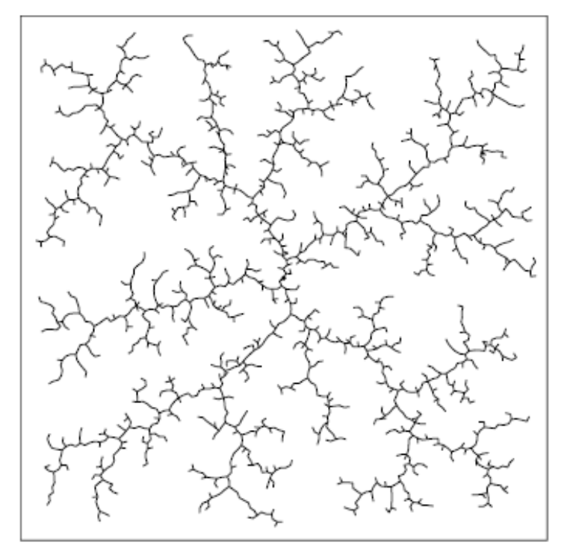
RRT and Dual RRT (Bidirectional Search)
Dual RRT with bi-directional search

Slide 30
Bidirectional RRT Algorithm
RRT-Create (Tree T, State src, State dest)
1: T1 = {src}; T2 = {dest}
2: while( true )
3: X = Random-State( );
4: if( Extend( T1, X, Xn) != TRAPPED )
5: then if( Extend(T2, Xn, Xn’) == REACHED)
6: then break;
7: swap( T1, T2 );
Extend( Tree T, State Xr, State &Xs )
1: Xn = Nearest-Neighbour(T, Xr)
2: Xs = SuccessorState(Xn, X, U)
3: if( collision-free( Xs ) )
4: then T = T U { Xs };
5: else return TRAPPED;
6: if( Xs is-close-enough-to Xr )
7: then return REACHED;
8: else return ADVANCED;
Efficient for one-time queries
Multiple rendezvous points
Faster search
HEURISTICS USED:
Goal-bias – by a coin flip, either a random state or the target state is used.

Slide 31
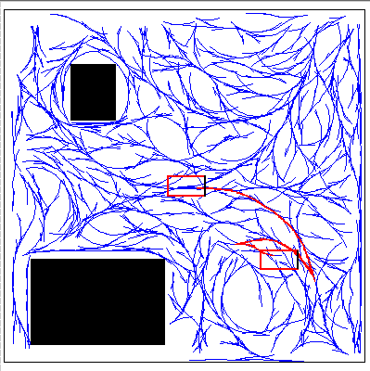
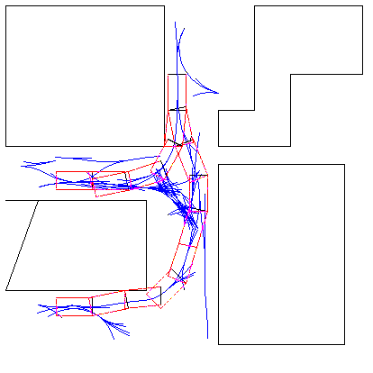
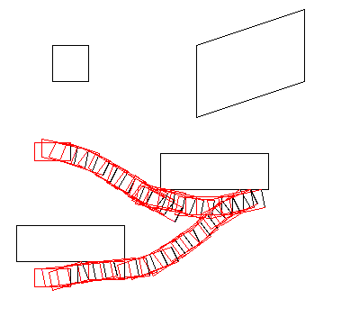
Results with RRTs
Exploring with RRTs
Unbiased RRT search
Goal-biased RRT search

Slide 32
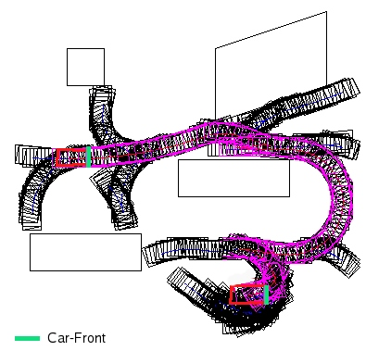
Some Results

Slide 33
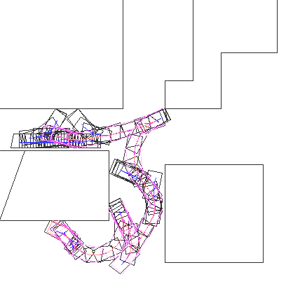
Results with RRTs
Unbiased bi-directional search usually yields such sub-optimal paths as the one shown in the figure.
The black pink represents the actual car path, while he black represents the exploration conducted by the tree

Slide 34
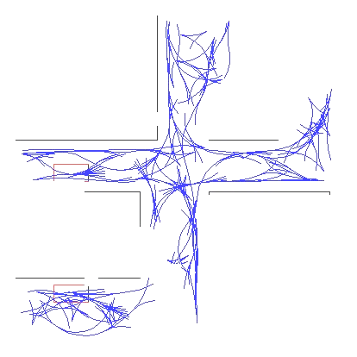
Results with RRTs
Unbiased bi-directional search is great for exploring in the state-space.
A possible application could be store the pre-explored map as an incomplete planner.

Slide 35
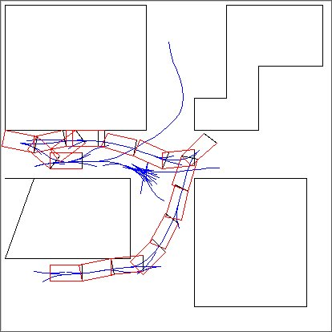
Results with RRTs
Biased (goal-biased) bi-directional search gives good results for difficult cases.

Slide 36
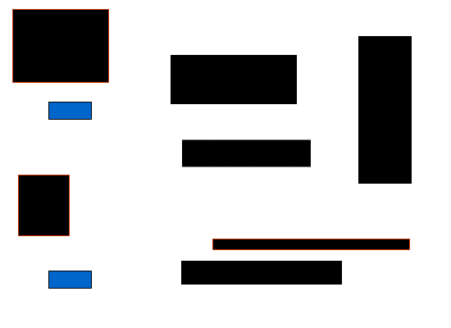
Results with RRTs

Slide 37
Problems with RRT
The RRT bypasses the need for a local planner. Hence it is always difficult to reach the final state exactly or even nearly exactly through a discrete search
The RRT uses a metric by which it decides the node closest to the random state. However many a time deciding the metric is equivalent to solving the motion planning problem as such. In other words there is no suitable or appropriate metric often to decide closeness between two states.
Bidirectional RRT: Find it out☺

Slide 38
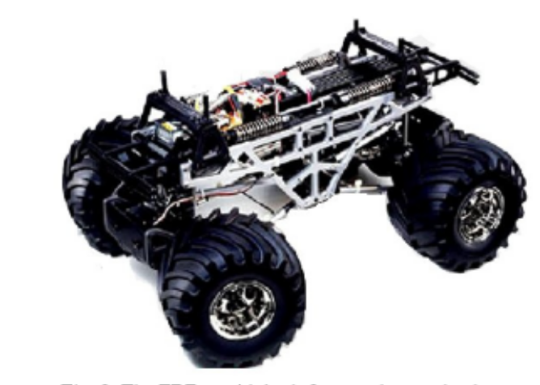
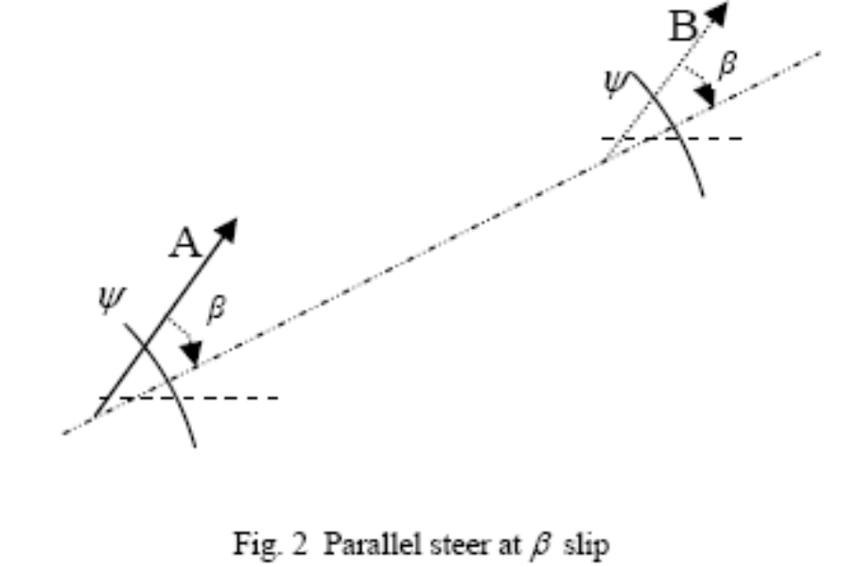
The FR SteerBot at iRL
Has both front and reer wheel steer
Gives rise to a smaller turning radius (can navigate in tighter spaces)
Also has the property of parallel steer

Slide 39
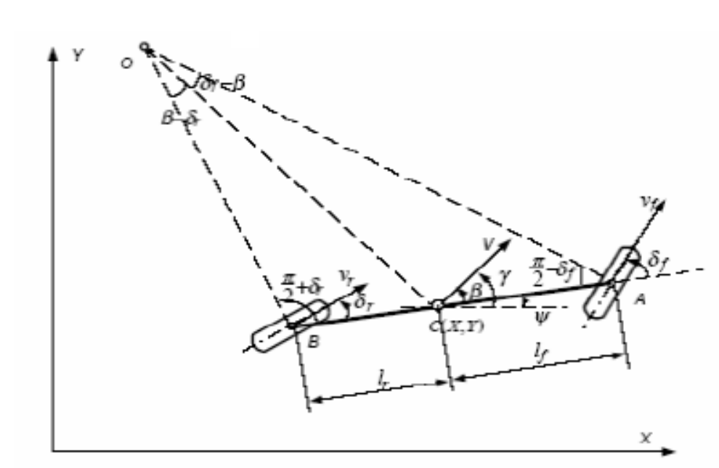
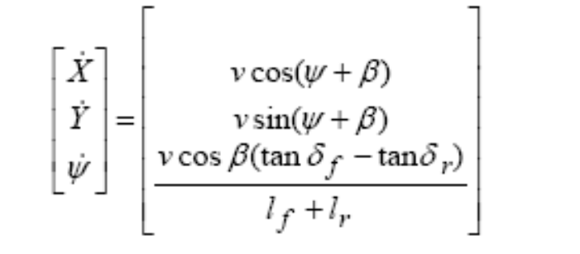
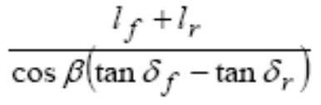
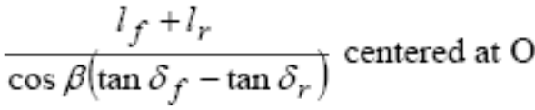
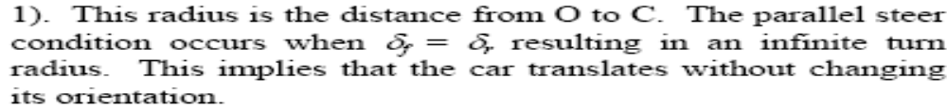
Kinematics of the FR Bot
The radius of the car is given by

